Slide 1


Flow Temperature Characterization of a Mach 5 Wind Tunnel
By: Veer Nayyar
Mentored by Dr. Alex Craig and Brian S. Kinsey
Boundary Layer Stability and Transition Laboratory
University of Arizona

Slide 2
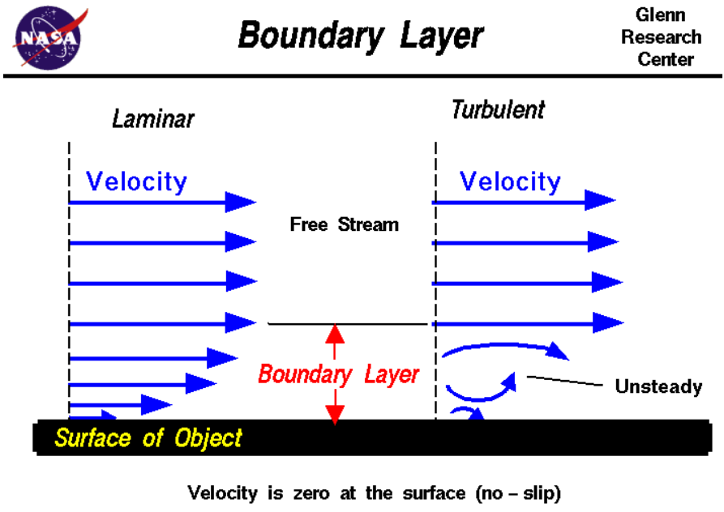
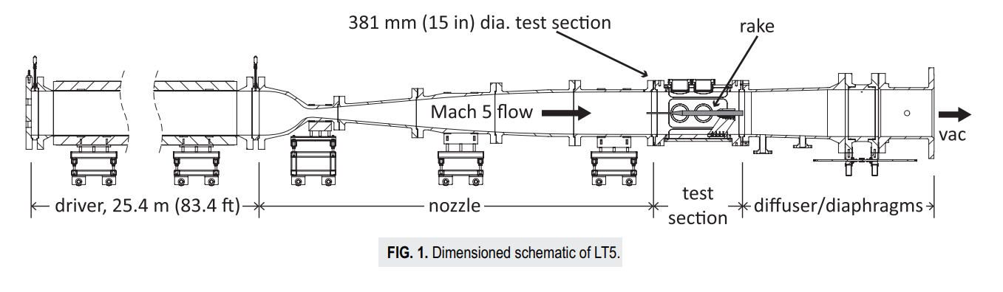
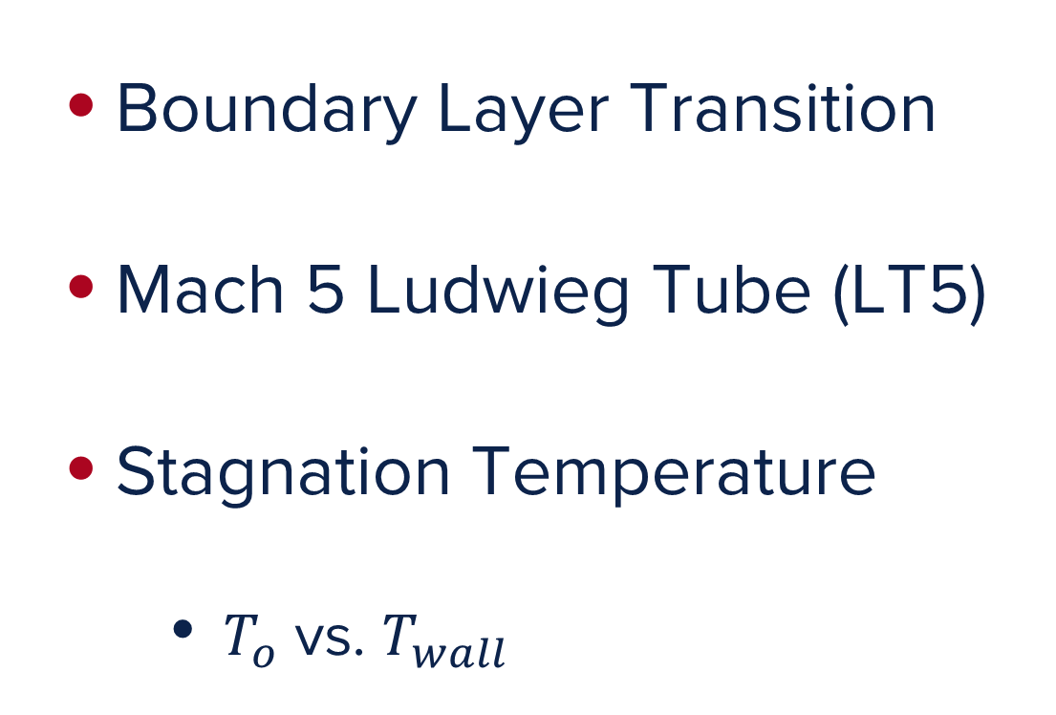
Background
Boundary Layer Transition
Mach 5 Ludwieg Tube (LT5)
Stagnation Temperature
$T_{o}$ vs. $T_{wall}$
Bearden et. Al (2020)

Slide 3
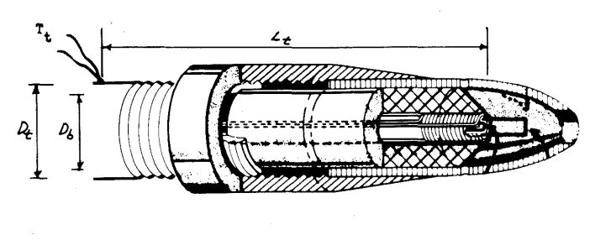
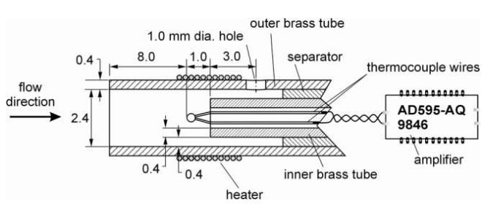
Objectives
Design, manufacture, and test a purpose-built total temperature probe
Gather reliable temperature measurements to inform future research
Identify LT5 operating parameters
Wood (1959)
Buttsworth, Widodo (2010)

Slide 4
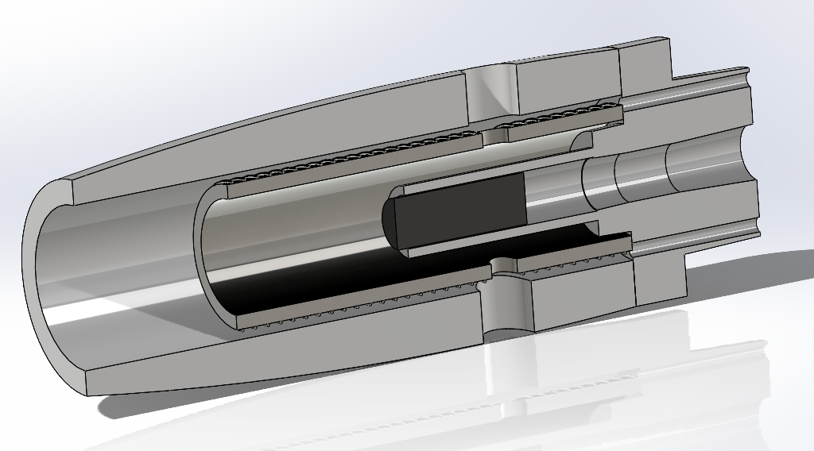
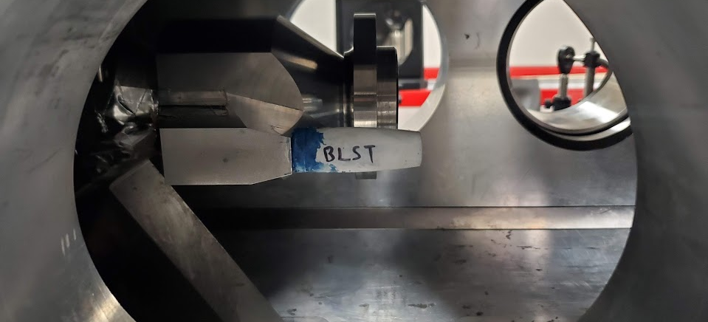
Probe Design
Ahmic Thin-Film platinum resistance thermometer (PRT)
Rigid 10K casings
Stainless steel housing
Nichrome alloy heating wire

Slide 5
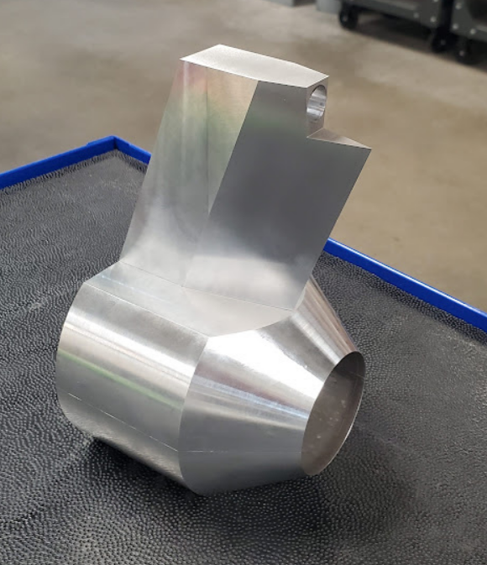
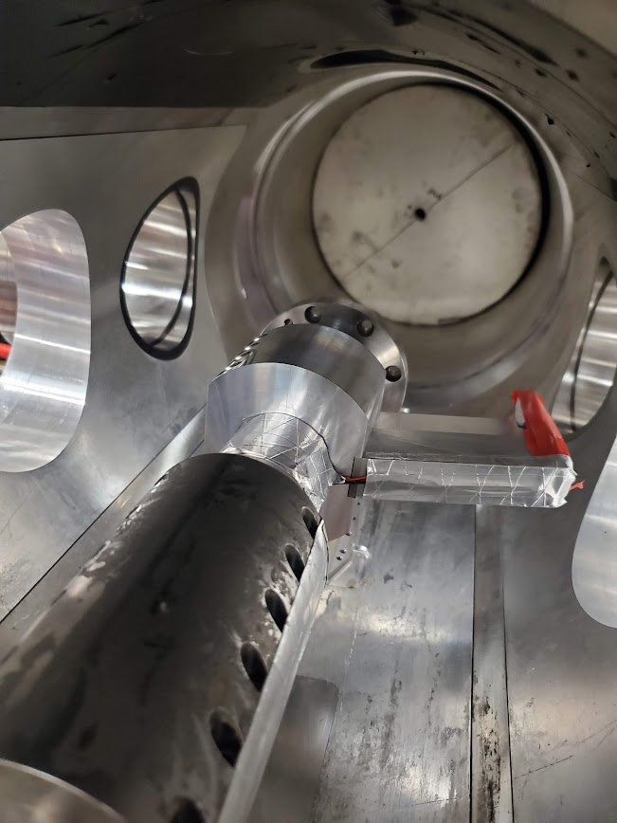
Mounting Hardware
1” radius adjustable clamps
8 counterbored, threaded slots
Can be mounted in tandem with experimental models
Extended wedge
3.8” vertical projection
Wire routing, probe mounting

Slide 6
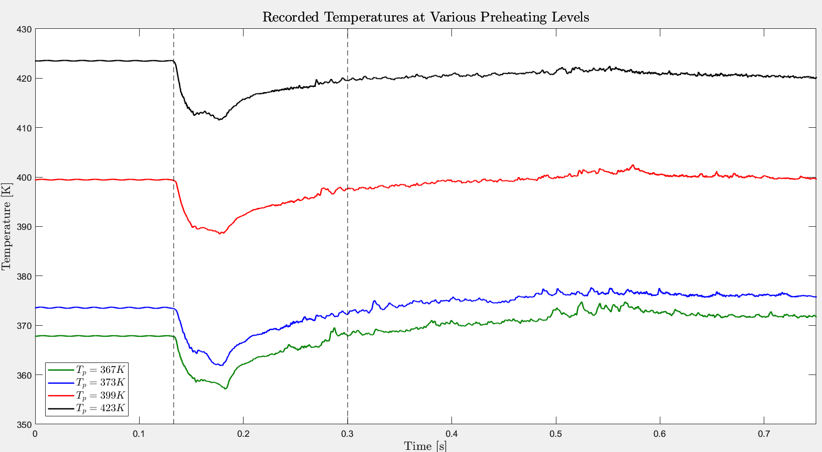
Wind Tunnel Testing
4 tests completed
Identical initial signal response due to isentropic expansion
Total temperature measured within 0.15 seconds after tunnel fires

Slide 7
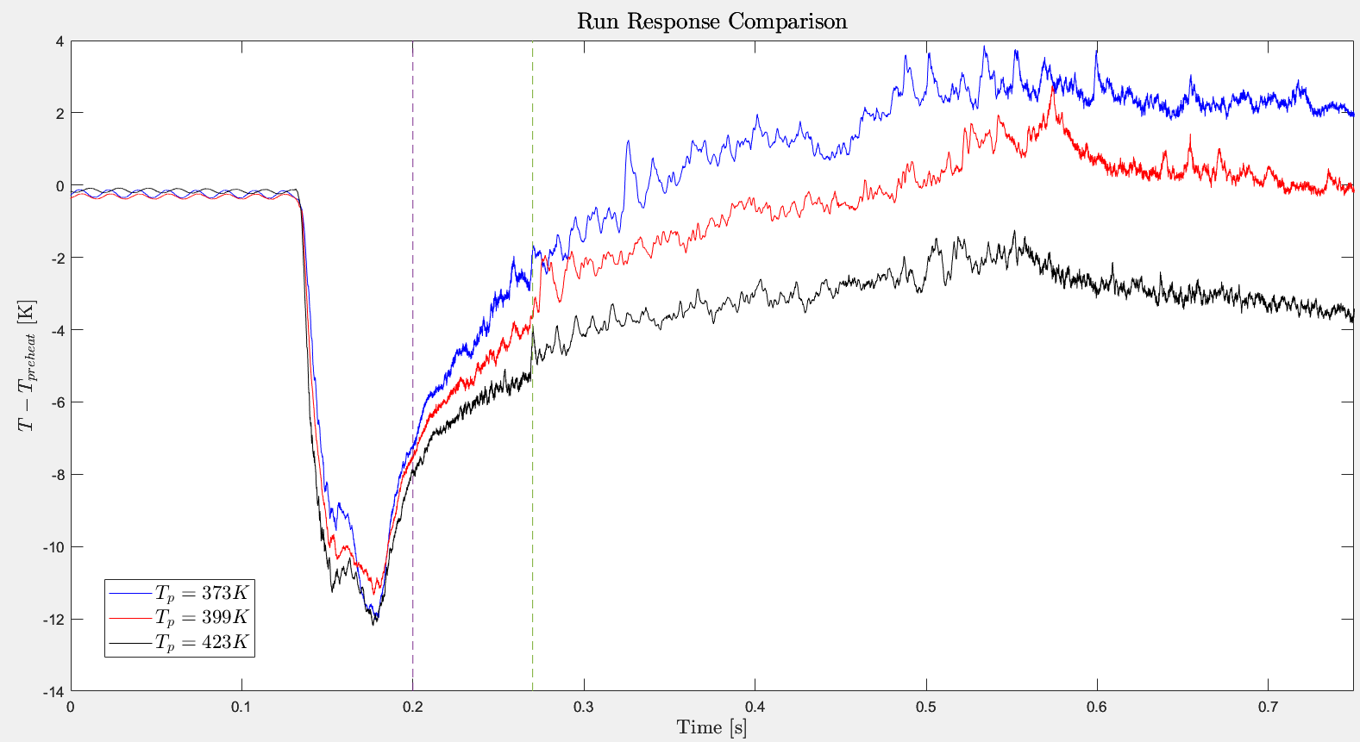
Wind Tunnel Testing
Preheats near total temperature reduce overall signal response amplitude
Signal behavior deviates during flow stagnation
Narrows search window for future total temperature measurements

Slide 8
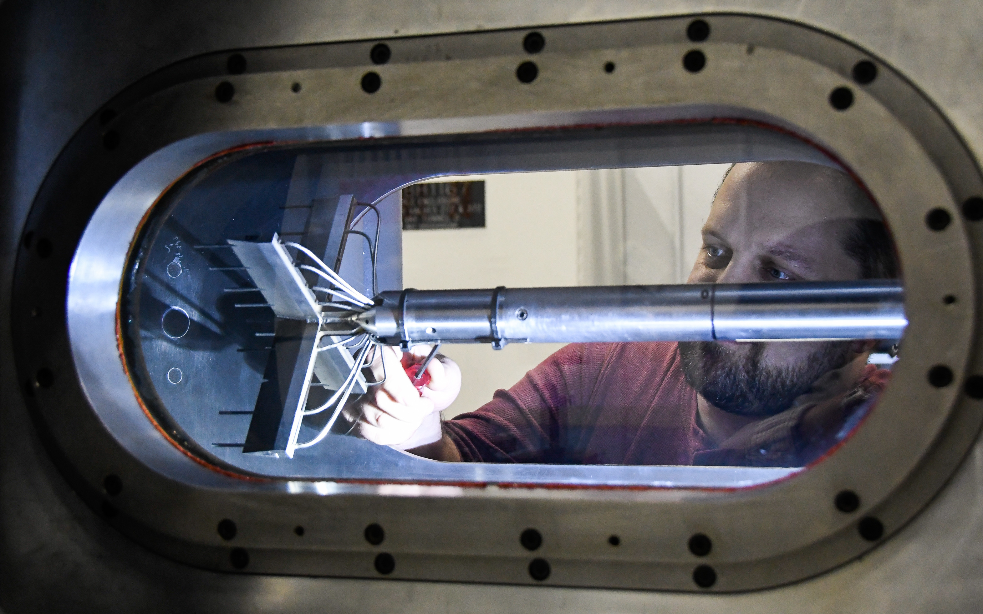
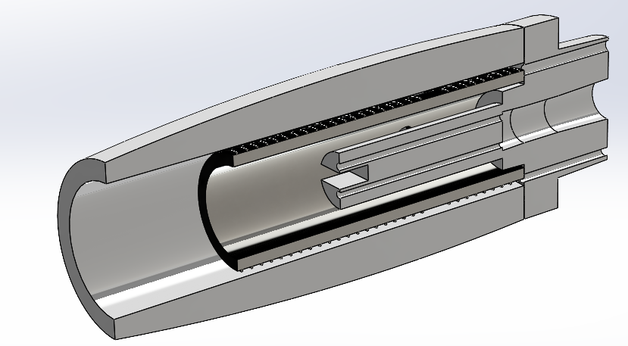
Conclusions and Future Research
Developed and tested purpose-built measurement hardware
Determined specific search criterion for future experiments
Redesign probe to house thermocouples
Develop flow temperature profile with multi-point measurement hardware
Understand discrepancies between measured total temperature and numerical models
Arnold Air Force Base

Slide 9
Acknowledgements
NASA Arizona Space Grant Consortium
Dr. Alex Craig and Brian Kinsey
BLST colleagues and fellow space grant interns

Slide 10
Thank You

